Slide 1


HR DATA INSIGHTS

Slide 2
Our Team
Mohamed Gamal
Mohamed Badawy
Omnia Hosny
LinkedIn
LinkedIn
LinkedIn
Ahmed Abdelfattah
Hoda Ibrahim
LinkedIn
LinkedIn

Slide 3

OVERVIEW
01
02
03
Business Problem
Our Objective
Describe Data
04
05
06
Analysis
Prediction
Recommendations

Slide 4




BUSINESS PROBLEM
34%
High employee turnover is costly, impacts morale, and affects overall productivity. HR needs data-driven insights to reduce turnover and identify the reasons behind terminations and resign.
20%
The average cost of replacing an employee is 20% of their salary, impacting profitability.

Slide 5


OUR DATA
Salary
Position
State
DOB
Gender
Marital Desc
Citizen Desc
Hispanic Latino
Race Desc
Date of Hire
Date of Termination
Term Reason
Employment Status
Department
Recruitment Source
Performance Score
Engagement Survey
Emp Satisfaction
Last Performance Review_Date
Days Late Last 30
Absences
Married ID
Marital Status ID
Gender ID
Emp Status ID
Dept ID
Perf Score ID
From Diversity Job Fair ID
Salary
Absences
Age
Special Projects Count
Recruitment Source
Analytics
Prediction

Slide 6


Cleaning & Transformation

Slide 7

Cleaning & Transformation
Convert date Columns to date type
Impute Outliers of date of birth based on Statistical Data
create a new columns for Engagement Survey, Emp Satisfaction to
EngagementSurvey_Status, EmpSatisfaction_Status respectively by
labels ['unsatisfy', 'neutral', 'satisfy']
Update Employment Status Column
Terminated for Cause: Terminated
Voluntarily Terminated: Resigned
create a new columns Sentiment analysis to classify Terminated Reasons to
negative, nature, positive
create a new columns to calculate Age

Slide 8
Univariate Analysis

Slide 9

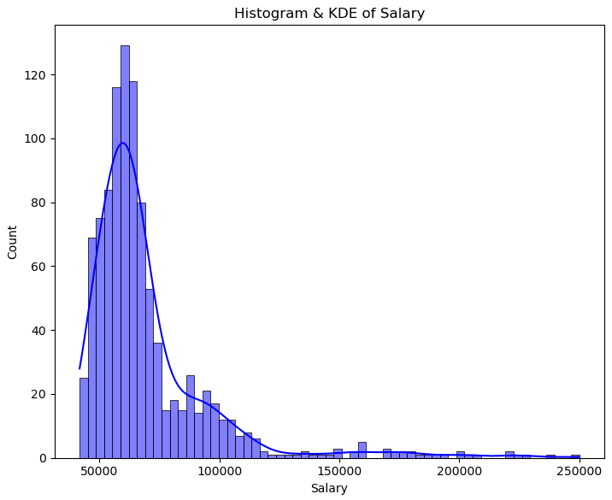
Salary
Salary Compression: The tight clustering of salaries in the $45,000 to $85,000 range may suggest salary compression, where the majority of employees have similar compensation regardless of their roles or experience.
Potential for Turnover: If the lower-paid employees feel their compensation doesn’t match their workload or market rates, this could be a driver for turnover.
Executive or Specialized Roles: The presence of high-salary outliers may correspond to specialized or executive roles. It could be valuable for HR to assess whether these roles align with organizational growth or if compensation is justified by performance.

Slide 10
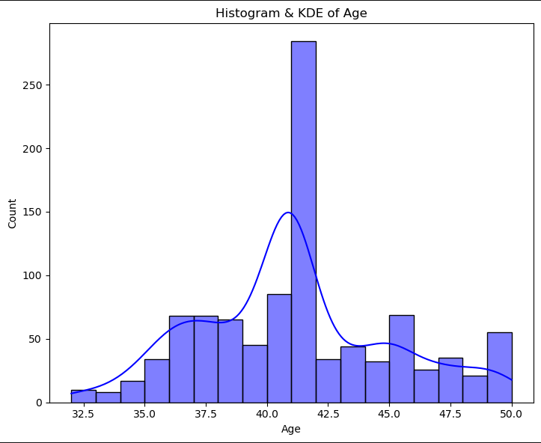
Age
The age cluster around 40 shows that most employees are around that age, as seen by the large spike in the graph. This indicates that many workers are in their mid-career stage.

Slide 11
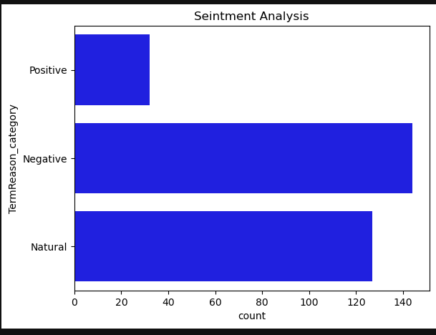
Sentiment Analysis
The most of TurnOver because Negative feedback.

Slide 12
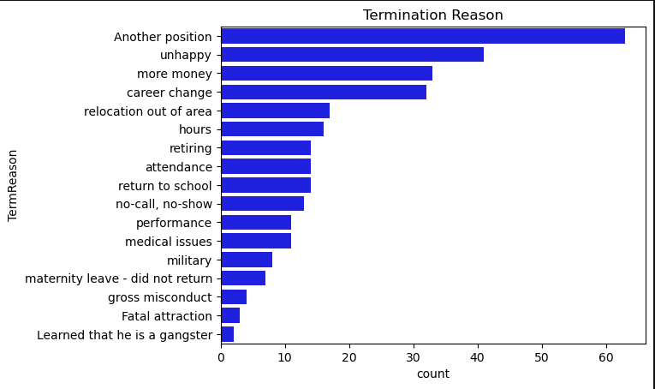
Termination Reason
The most of termination Reasons,
Another Position
Unhappy
More Money
This is refer to we have a problem in our environment

Slide 13
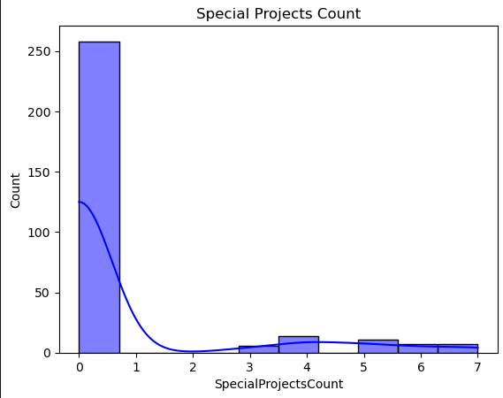
Special Projects Count
The most of termination Reasons,
Another Position
don’t work project
This is refer to we have a problem in our environment

Slide 14
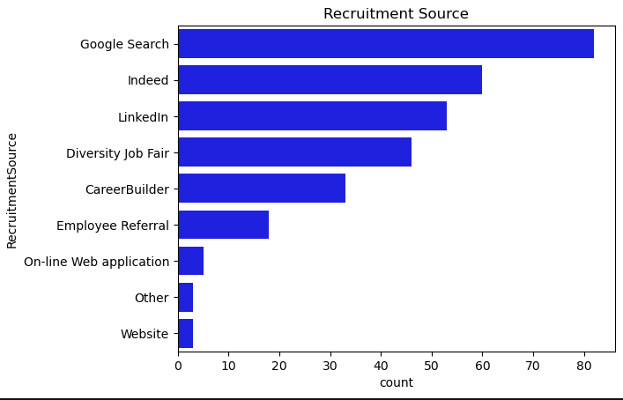
Recruitment Source
The most of Recruitment Source for people that terminated or Resigned From,
Google Search
Indeed
LinkedIn
This is refer to we need to change the way or more invest time for hiring process

Slide 15
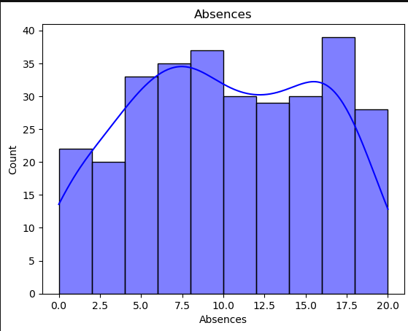
Absences
The most of Reasons for people that terminated or Resigned is attendance
we have another insight that tell most terminated people have avg. Absences 15 days

Slide 16
Multivariate Analysis

Slide 17
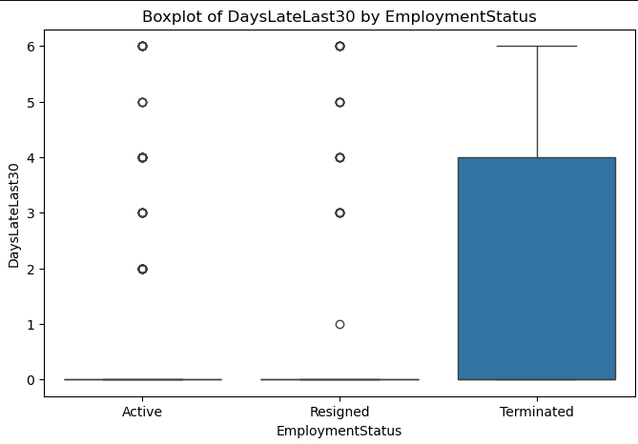
Days Late Vs. Terminated
The most of Reasons for people that terminated or Resigned is Late
we have another insight that tell 75% terminated people have 5 Late days

Slide 18
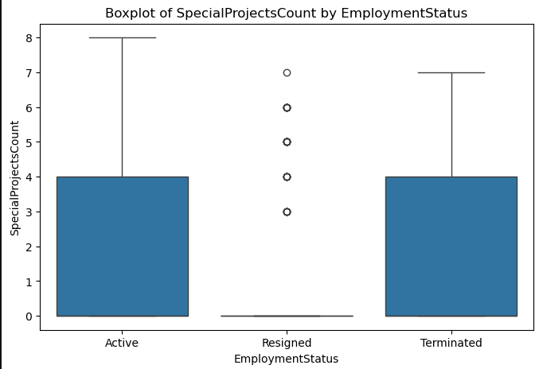
Number of Projects Vs. Status
The Addition Reasons for people that Resigned is they doesn’t work

Slide 19
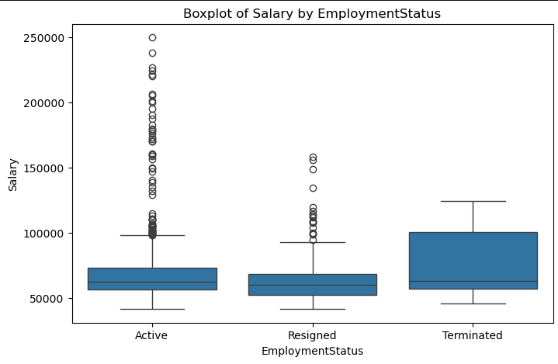
Salary Vs. Status
The people are still working have good Salaries

Slide 20
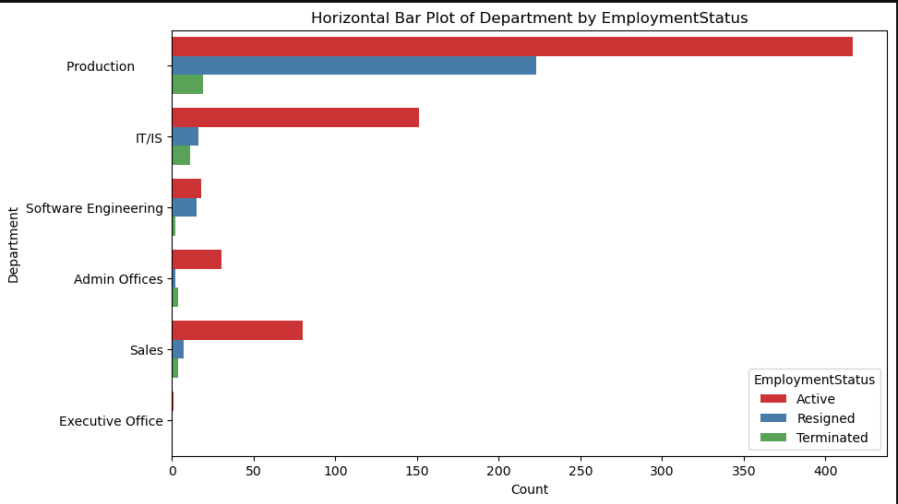
Department Vs. Status
Is that for low salary for production department. We need collect more data invest why ?

Slide 21
Predictive Model for Turnover & Termination

Slide 22
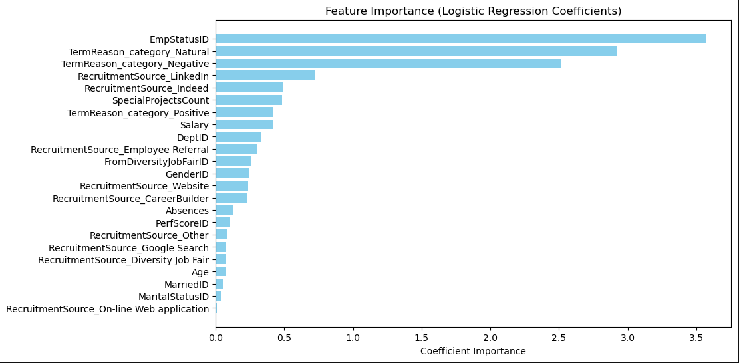
Feature Importance
Goal: Predict whether an employee will be terminated or not based on their features.
Model choice: Logistic Regression
performance metrics: Accuracy .
With 99% accuracy, we can now predict which employees are at risk of termination, allowing HR to proactively intervene

Slide 23
Key Insights & Recommendations

Slide 24

Key Drivers: Salary, Absences, Late Days, Number of Projects, Age,and Department are key indicators of potential turnover.
Turnover Trends: Product department have higher turnover, employees of avg. Age = 42 are most at risk.
Recommendations: Based on your analysis, propose actionable strategies for HR:
Offer better engagement programs for high-risk employees.
Create targeted retention programs in departments with high turnover.
Improve Policy of Attendance for employees
Provide competitive Salaries of Mid Level
Provide Chanaging for develop career
January
May

Slide 25

NEXT PROJECT
Create Recommendation System
to Recommend for each employee course and project to develop themself

Slide 26

Thank's For Watching
Connect with us.

